Slide 1

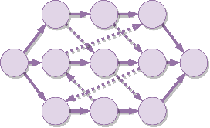




Learning to Dispatch for Job Shop Scheduling via Deep Reinforcement Learning
Cong Zhang¹, Wen Song², Zhiguang Cao³, Jie Zhang¹, Puay Siew Tan⁴, and Chi Xu⁴
¹Nanyang Technological University
²Institute of Marine Science and Technology, Shandong University, China
³National University of Singapore
⁴Singapore Institute of Manufacturing Technology, A*STAR

Slide 2
Background
Learning to dispatch (L2D)
Experiment
Conclusion
CONTENTS

Slide 3
Background
Learning to dispatch (L2D)
Experiment
Conclusion
CONTENTS

Slide 4


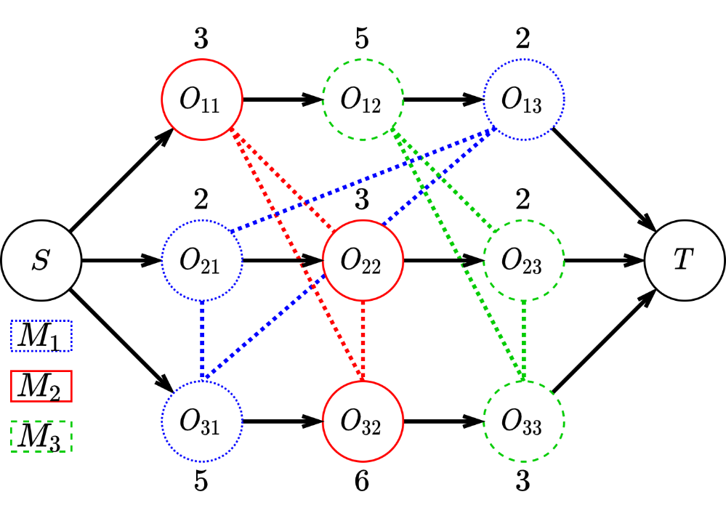
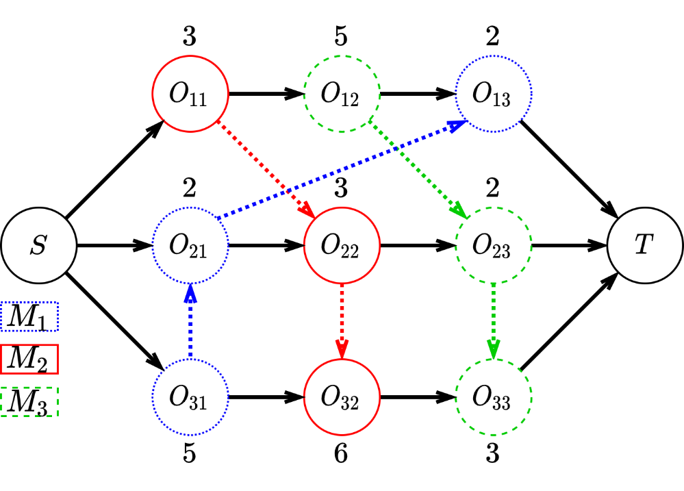
1
Background
Job-Shop Scheduling Problem & Disjunctive Graphs
Job-Shop Scheduling Problem (JSSP) is a well-known Combinatorial Optimization Problem (COP) that is NP-hard to solve.
$𝒥=\{J_{1}, …, J_{n}\}$, $ℳ=\left\{M_{1}, …, M_{m}\right\}$, $ℱ=\left\{F_{1}, …, F_{n}\right\}: 𝒥→ℳ^{m}$, $Obj: \min_{∀1≤i≤m, seq(M_{i})}{C_{max}}$ s.t ${ ∀j, F}_{j}∈ℱ$ holds
Disjunctive Graph (DG) is a concise way of representing combinatorial properties of JSSP and schedules.
(a) JSSP instance
(b) Complete Solution

Slide 5
1
Background
Motivation
Priority Dispatching Rule (PDR) is a class of heuristics that is widely used to solve real-world JSSP:
Based on some calculated priority indices, it schedules, within the current waiting list, the job with highest index.
However, the design of effective PDRs is a tedious task:
Requiring a myriad of specialized knowledge;
Delicate and limited performance for different JSSPs;
Q: How to search the PDR space automatically to find PDR that has robust generalization and strong performance?
Notes:
asdasda

Slide 6

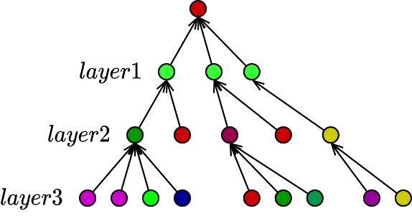
1
L2D
Challenges
Challenges
Due to strong NP-hardness, how to search the PDR space efficiently and effectively in an end-to-end & un-supervised manner?
Can learning be size-agnostic so that learned PDR would generalize to un-seen large-scale instances?
Graph Neural Networks
+
Learning to Dispatch

Slide 7
Background
Learning to dispatch (L2D)
Experiment
Conclusion
CONTENTS

Slide 8




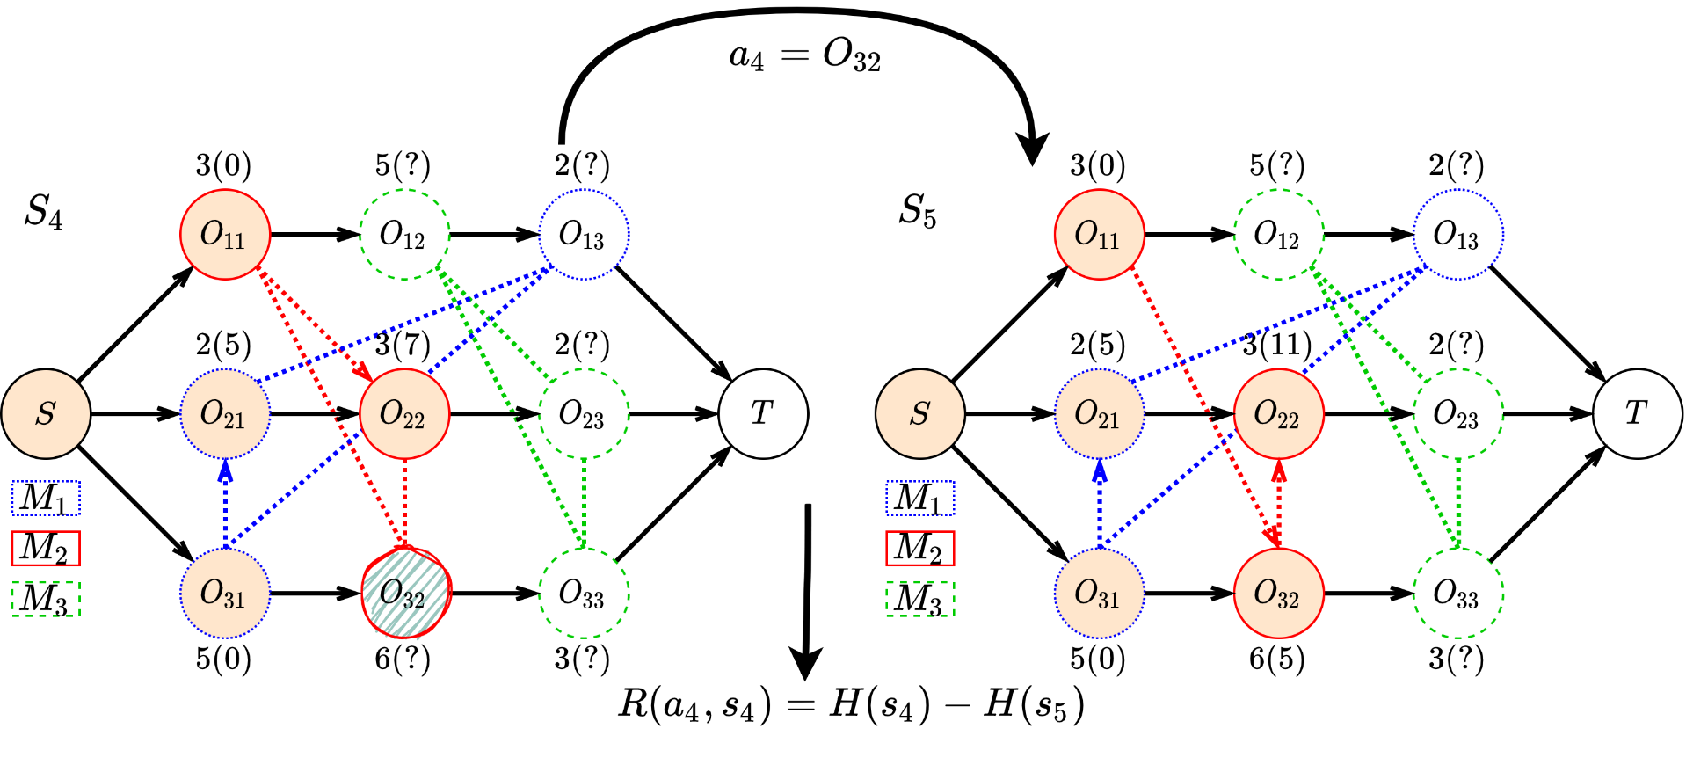
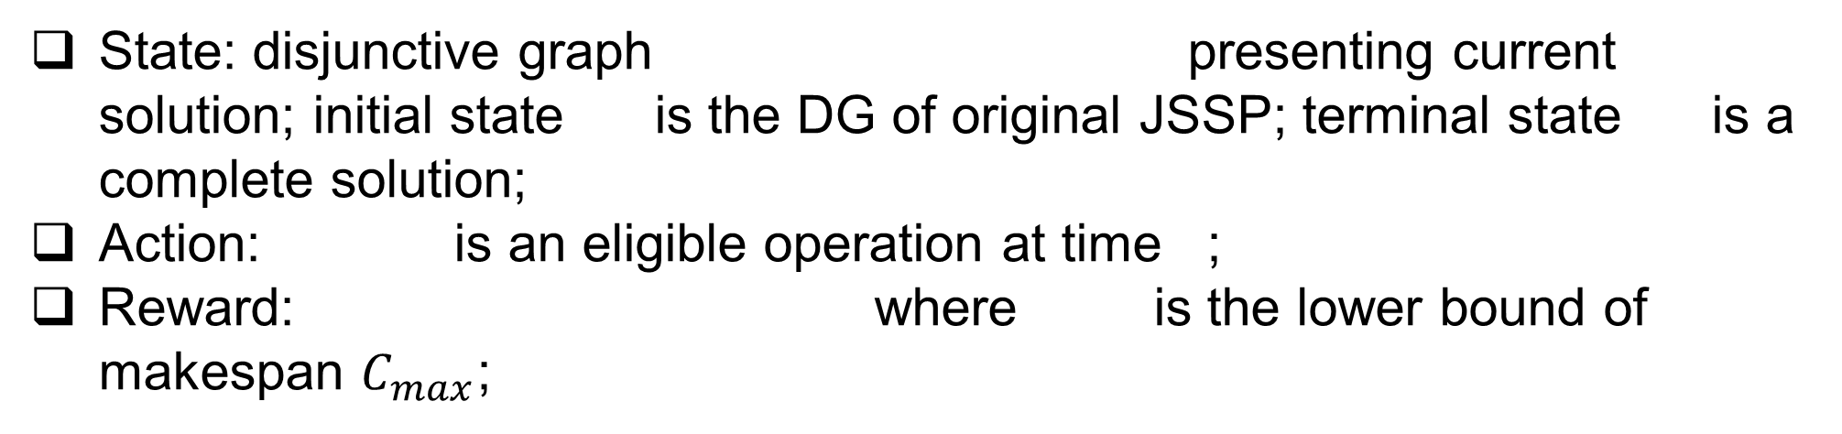
2
L2D
Markov Decision Process Formulation
State: disjunctive graph presenting current solution; initial state is the DG of original JSSP; terminal state is a complete solution;
Action: is an eligible operation at time ;
Reward: where is the lower bound of makespan $C_{max}$;

Slide 9
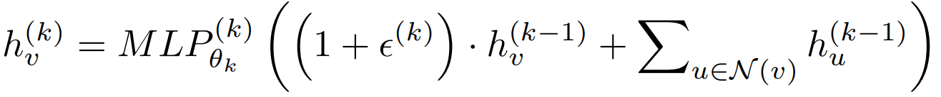
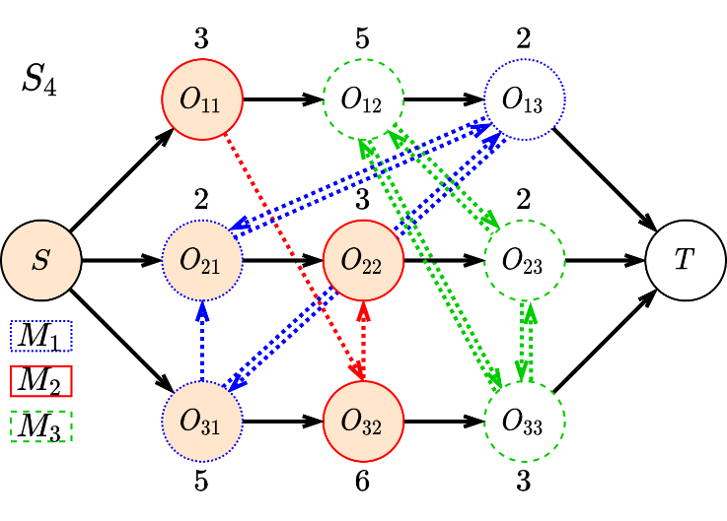


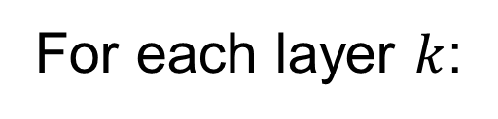

2
L2D
Parameterizing the Policy
We use GIN as state embedding network as it is one of the strongest GNN for homogeneous graphs with proved discriminative power.
For each layer $k$:
sample
$$GIN$$
$$π(a_{4}|{embedding}_{S_{4}})$$
$$a_{4}$$
Proximal Policy Optimization (PPO) as optimizer

Slide 10
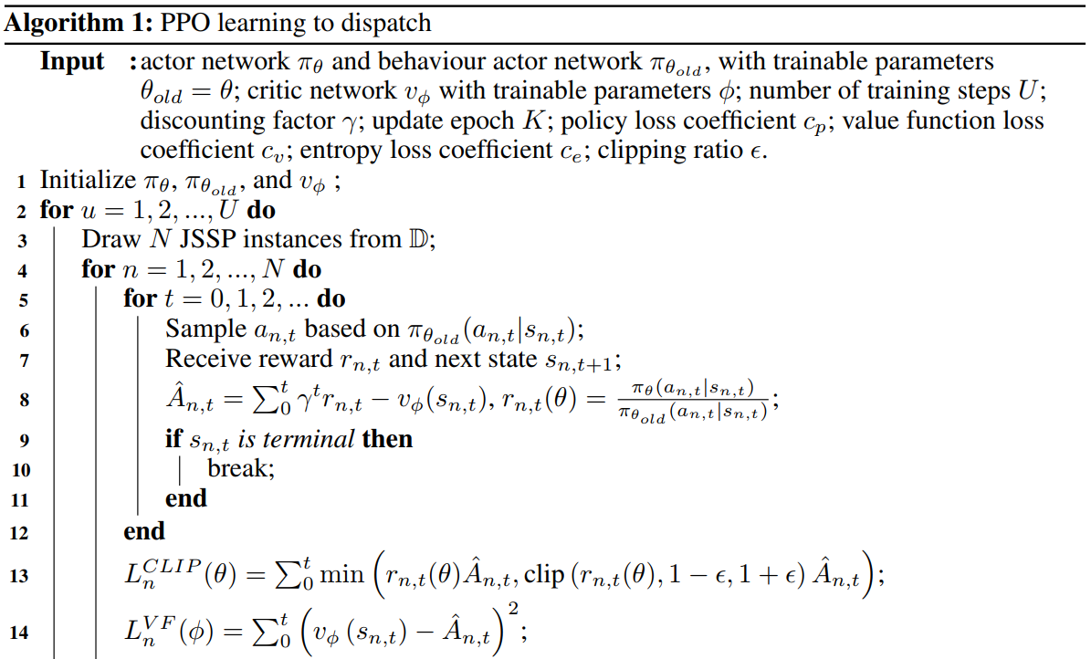
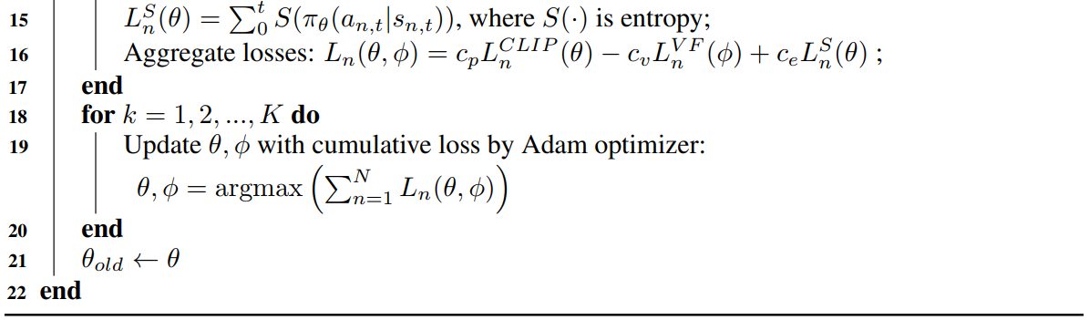
2
L2D
Learning Algorithm
We choose Proximal Policy Optimization as optimizer of our agent:
Optimizing our agent over four independent JSSP instances per iteration;

Slide 11
Background
Learning to dispatch (L2D)
Experiment
Conclusion
CONTENTS

Slide 12
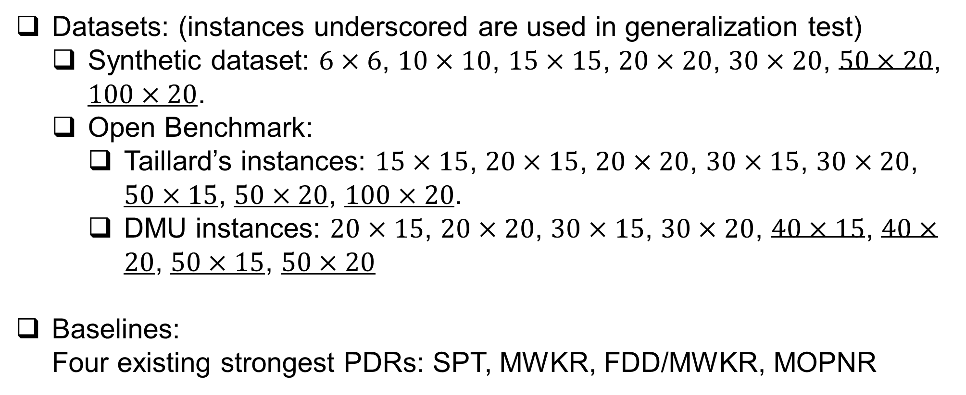
3
Experiment
Datasets & Baselines
Datasets: (instances underscored are used in generalization test)
Synthetic dataset: $6×6$, $10×10$, $15×15$, $20×20$, $30×20$, $50×20$, $100×20$.
Open Benchmark:
Taillard’s instances: $15×15$, $20×15$, $20×20$, $30×15$, $30×20$, $50×15$, $50×20$, $100×20$.
DMU instances: $20×15$, $20×20$, $30×15$, $30×20$, $40×15$, $40×20$, $50×15$, $50×20$
Baselines:
Four existing strongest PDRs: SPT, MWKR, FDD/MWKR, MOPNR

Slide 13
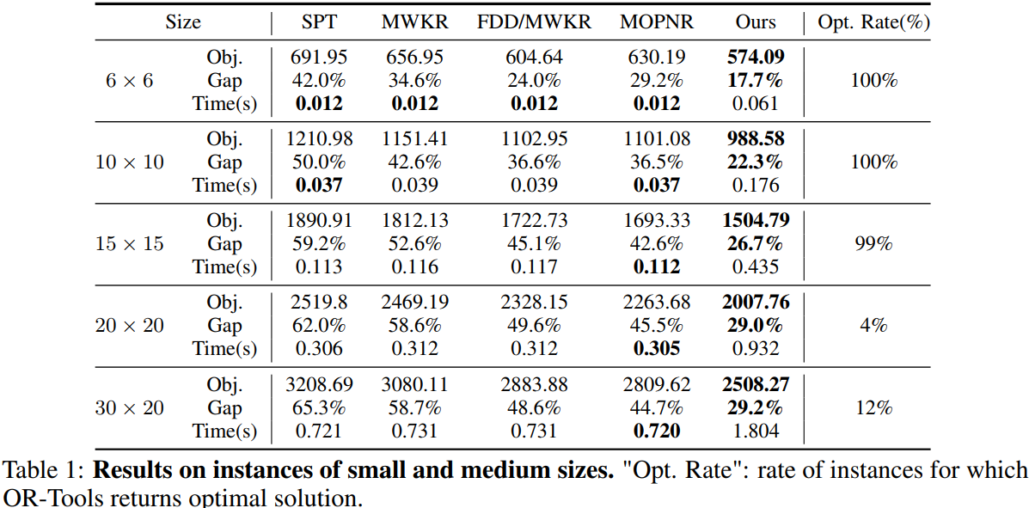
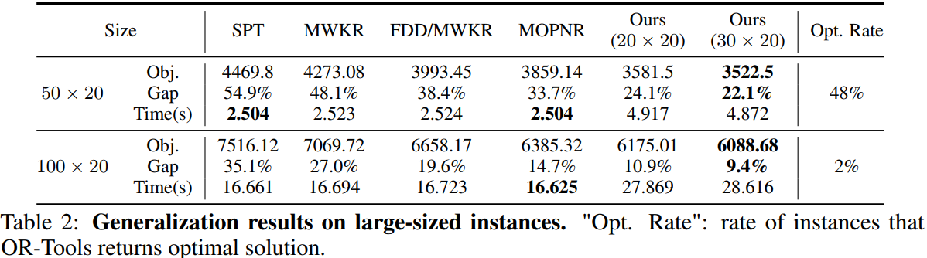
3
Experiment
Results on Synthetic Dataset

Slide 14
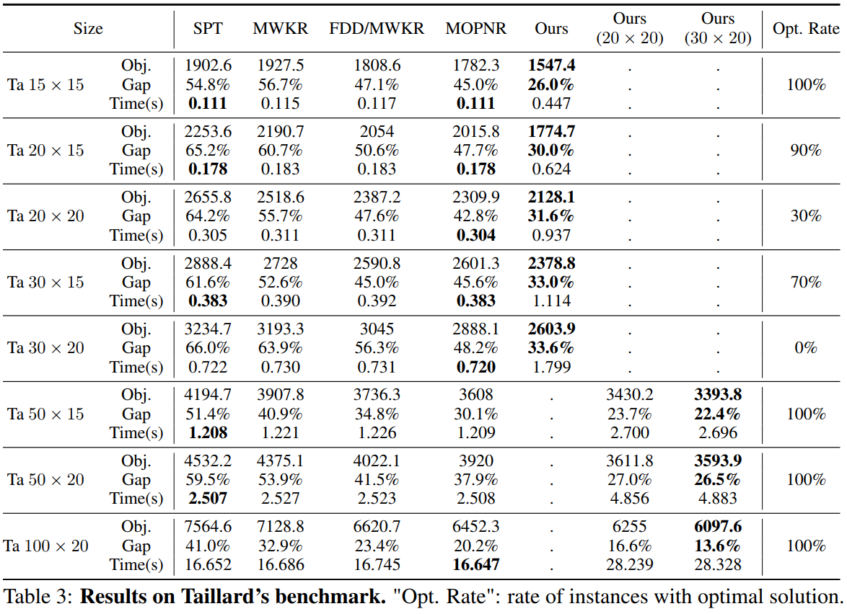
3
Experiment
Results on Open Benchmarks - Taillard

Slide 15
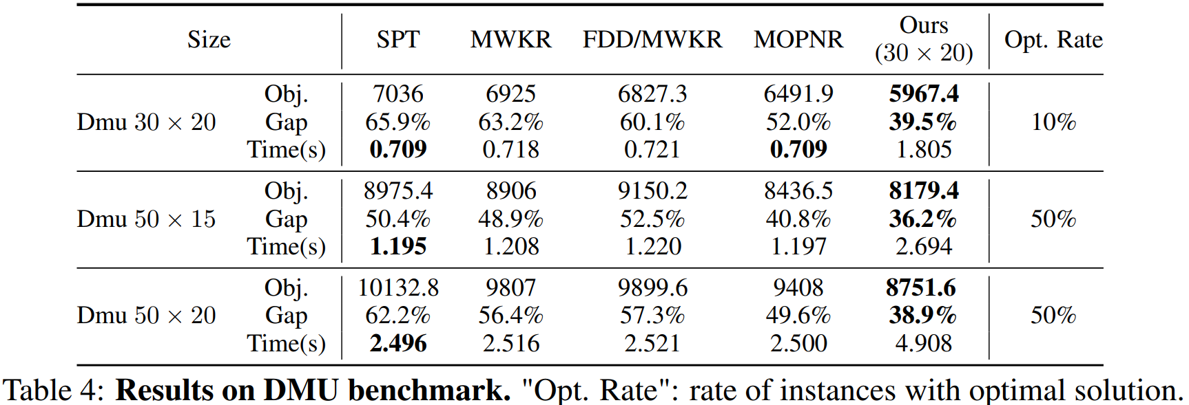
3
Experiment
Results on Open Benchmarks - DMU

Slide 16
Background
Learning to dispatch (L2D)
Experiment
Conclusion
CONTENTS

Slide 17
4
Conclusions
It is the first attempt to directly learn strong PDRs based on disjunctive graph representation.
Learned PDR has robust generalization.

Slide 18
Thank you !

